Slide 1
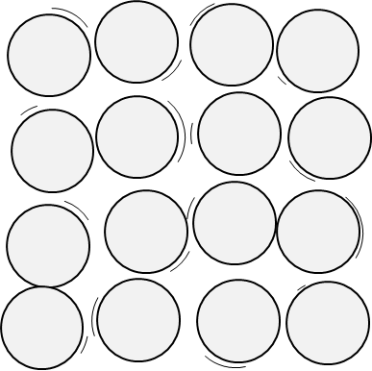
Pie tin particles
John has just made a fruit pie.
It is ready to go into the oven
The particles in the pie tin are arranged in a regular pattern.
They are vibrating and bumping into each other.
Pie tin

Slide 2
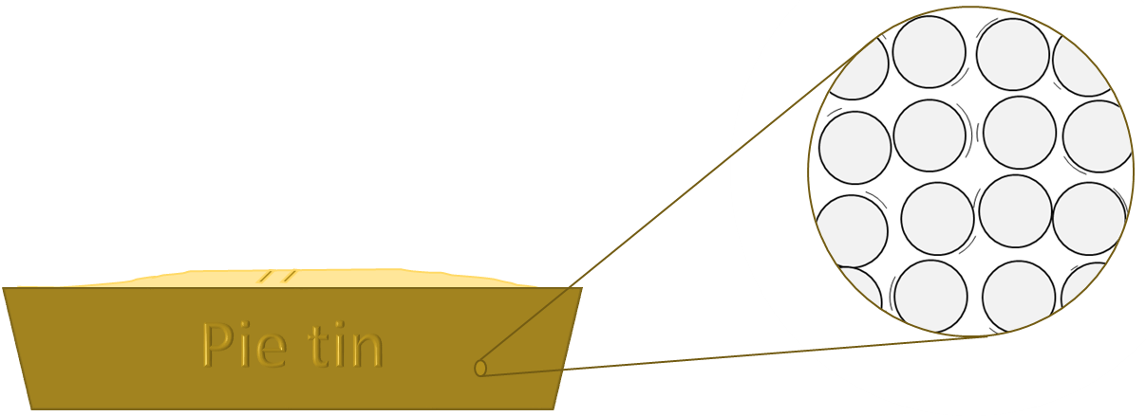
Pie tin particles
In the oven the pie tin
heats up to 180ºC.
What do you think happens to the particles?
I am sure this is right
I think this is right
I think this is wrong
I am sure this is wrong
A
They get heavier
B
They get bigger
C
They vibrate more quickly
D
They push into each other with more force
E
They change shape

